Slide 1


OpenGL Multisample
Sébastien Dominé

Slide 2


Agenda
What is multisample?
WGL extensions? WGL_ARB_extensions_string
New way to query pixelformat?
  WGL_ARB_pixel_format
How to query for a multisample pixelformat?
  WGL_ARB_multisample
How to enable multisample in the application?
  GL_ARB_multisample
How to obtain a specific kernel filter on NVIDIA cards?
  GL_NV_multisample_filter_hint
Conclusion

Slide 3
Getting started...
Based upon WGL_ARB_multisample
Requires WGL_ARB_extensions_string and WGL_ARB_pixel_format
Allows the application to get a multisampled frame buffer with a given number of samples per pixels
Multisample filtering taxonomy:
  Sample : a subpixel frame buffer sample containing color, depth, and stencil information
  Tap : source of data for filtering
Not the same as Supersampling – no notion of Tap

Slide 4
Multisample pixel
1
1
8
8
1
2
1
1
2 Samples
8
5 Taps
8
2 Sample
5 Tap
Quincunx
Multi-Sampling

Slide 5
Multisample frame buffer
It doesn’t happen for free
More video memory is required:
Vid_mem =
sizeof(Front_buffer) +
sizeof(Back_buffer) +
num_samples * (sizeof(Front_buffer) +sizeof(ZS_buffer))

Slide 6
How does it happen in OpenGL
WGL_ARB_extensions_string
WGL_ARB_pixel_format
WGL_ARB_multisample
GL_ARB_multisample
GL_NV_multisample_filter_hint

Slide 7
WGL extension string
WGL_ARB_extensions_string
  Don’t search the GL string for it – it is a WGL extension!
  Query for the entry point:
    wglGetEntensionsStringARB = wglGetProcAddress(“wglGetEntensionsStringARB”)
    wglGetEntensionsStringARB != NULL
const char * wgl_ext_string = wglGetEntensionsStringARB(hDC);

Slide 8
New way to query pixel formats - Trick
Multisample window in OpenGL:
  WGL_ARB_pixel_format and WGL_ARB_multisample extensions
  Need to create a dummy window to collect the extensions and entry points bound to a hardware accelerated context
  Then you can create the multisample window

Slide 9
New way to query pixel formats
Win32 GL function
  ChoosePixelFormat, DescribePixelFormat are not extensible
WGL_ARB_pixel_format
  Array of paired attribute/value to describe a pixel format
  Adds wglChoosePixelFormat and wglGetPixelFormatAttrib{fi}vARB – still uses SetPixelFormat
  Well defined matching comparison function per attribute

Slide 10
WGL ARB pixel format
BOOL wglChoosePixelFormatARB( HDC hdc,
const int *piAttribIList,
const FLOAT *pfAttribFList,
UINT nMaxFormats,
int *piFormats,
UINT *nNumFormats);
float fAttributes[] = {0, 0};
int pixelFormat;
UINT numFormats;
int iAttributes[] = { WGL_DOUBLE_BUFFER_ARB, TRUE,
WGL_ACCELERATION_ARB, WGL_FULL_ACCELERATION_ARB,
0, 0 };
status = wglChoosePixelFormat(hDC, iAttributes, fAttributes,
1, &pixelFormat, &numFormats);

Slide 11
WGL ARB pixel format - Trick
If wglChoosePixelFormat succeeds, it doesn’t mean it found a matching PFD – need to test numFormats

Slide 12
WGL ARB pixel format
BOOL wglGetPixelFormatAttribivARB( HDC hdc,
int iPixelFormat,
int iLayerPlane,
UINT nAttributes,
const int *piAttributes,
int *piValues);
int iAttributes[3];
int iResults[3];
iAttributes[0] = WGL_DOUBLE_BUFFER_ARB;
iAttributes[1] = WGL_ACCELERATION_ARB;
iAttributes[2] = 0;
status = wglGetPixelFormatAttribivARB(hDC, pxlfmt, 0, 2,
iAttributes, iResults);

Slide 13
Query for a multisample pixelformat
WGL_ARB_multisample
  Add the following pixel format attributes:
    WGL_SAMPLE_BUFFERS_ARB
    WGL_SAMPLES_ARB
iAttributes[0] = WGL_SAMPLE_BUFFERS_ARB;
iAttributes[1] = 1;
iAttributes[2] = WGL_SAMPLES_ARB;
iAttributes[3] = 2; // could be 4
And call wglChoosePixelFormat...

Slide 14
Enable multisample
We now have a multisample window
  Enabling/Disabling multisample rasterization:
    glEnable(GL_MULTISAMPLE_ARB)
    glDisable(GL_MULTISAMPLE_ARB)

Slide 15
GL_ARB_multisample
Multisample Fragment Operations:
  Explicit Fragment Coverage Value
    void glSampleCoverageARB( GLclampf value, GLboolean invert)
  Assign Fragment Coverage Value based on Fragment Alpha
    Sub pixel Screen door transparency
  Force Fragment Alpha Value to 1

Slide 16
GL_NV_multisample_filter_hint
NVIDIA extension explicitly exposes the different filters:
glHint(GL_MULTISAMPLE_FILTER_HINT_NV, GL_FASTEST);
  glHint(GL_MULTISAMPLE_FILTER_HINT_NV, GL_NICEST);
GeForce 3/4Ti:
Samples | FASTEST | NICEST
2 | 2 Samples 2 Taps Box | 2 Samples 5 Taps Quincunx
4 | 4 Samples 4 Taps Box | 4 Samples 9 Taps Box

Slide 17
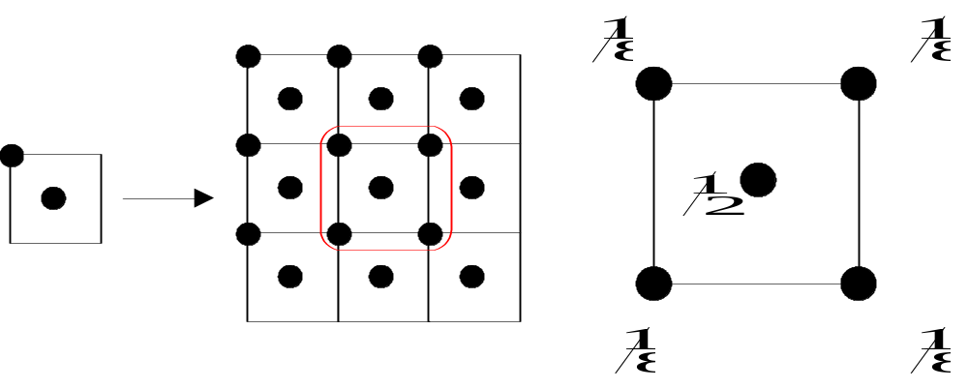
GL_NV_multisample_filter_hint
1
2
2 Sample
2 Tap
Box
Multi-Sampling
1
2
2 Sample
5 Tap
Quincunx
Multi-Sampling

Slide 18
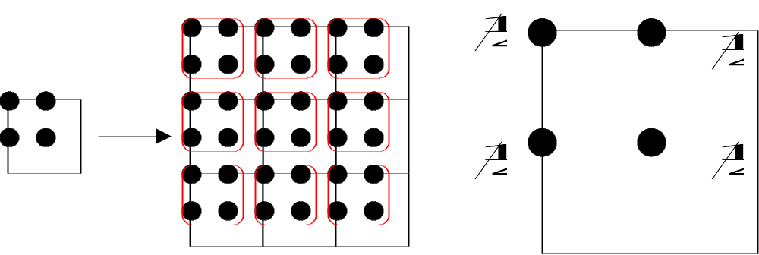
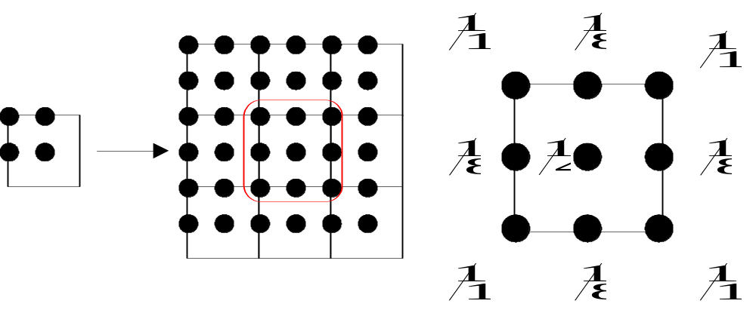
GL_NV_multisample_filter_hint
4 Sample
4 Tap
Box
Multi-Sampling
4 Sample
9 Tap
Box
Multi-Sampling

Slide 19
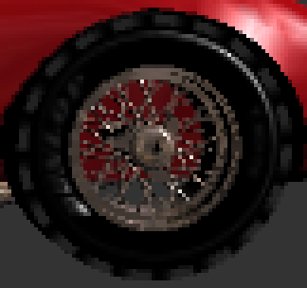

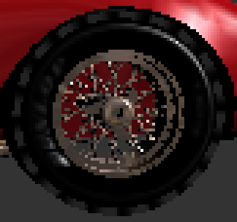


GL_NV_multisample_filter_hint
2 sample 2 tap
4 sample 4 tap
2 sample 5 tap
4 sample 9 tap

Slide 20
Performance considerations
Texture thrashing?
If T&L or CPU bound – Multisample can be cheap
Scalability forces the video options to enumerate all the modes
Test case – Quake III

Slide 21
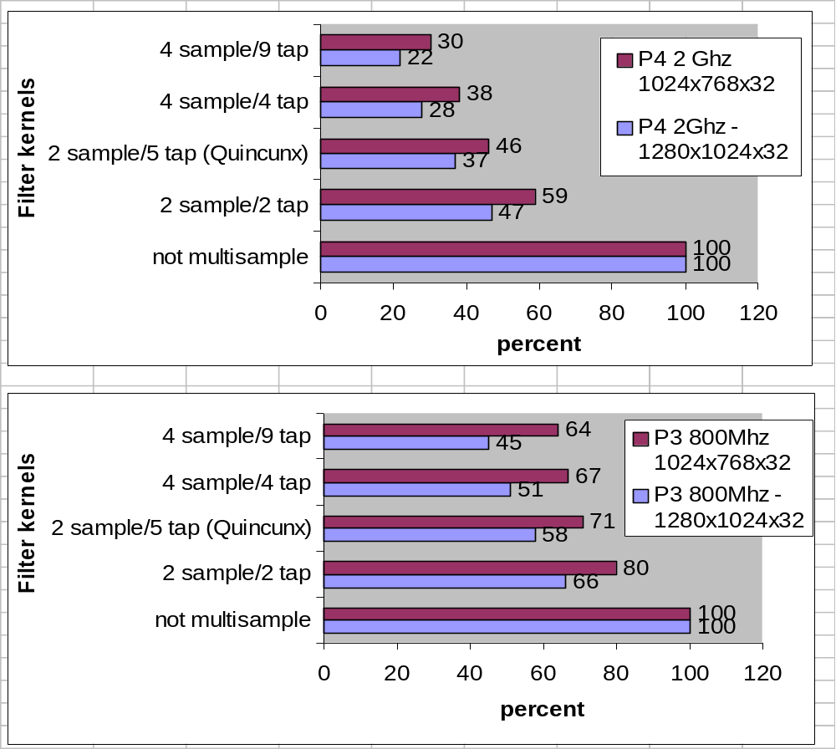
Performance considerations

Slide 22
Conclusion
Easy to support
Tremendous visual quality improvement
Explicit control of the what should or shouldn’t be antialiased
Doesn’t necessarily mean slowdown
Much nicer than a Display Driver control panel toggle
Demo
  NV Pixel Format 1.0

